Slide 1
Toxicity Classification in Civil Comments

Slide 2
Problem:
Toxicity classification in Civil comments/ online conversations on a public platform, focused on news articles.
A NLP task where comment texts are processed to learn the toxicity in them, to classify whether a comment is toxic or not; where toxicity is defined as anything rude, disrespectful or otherwise likely to make someone leave a discussion.
As part of a competition on Kaggle, the Conversation AI team, a research initiative founded by Jigsaw and Google, released the data labeled for toxicity. Crowdsourcing was used for annotation.
The problem can be divided into two parts: building a model to learn to classify toxicity in the comments; and mitigating the unintended model bias for identity terms(e.g. muslim, gay. Background: here)
For this project, we focus primarily on building a deep stacked Bi-LSTM model to train for the toxicity classification.
Data:
1.8 million civil comments labeled for toxicity
Initialization Details:
0.75/0.25 train and test division used for this project.
300d GloVe word embeddings pretrained on Wikipedia and Gigaword are used for input feature representation.
Dropout of 0.2 used on each LSTM layer. Adam optimizer is used.
Random Uniform initialization for Embedding weights. Glorot Uniform initialization for all hidden kernel weights, and Orthogonal initialization for recurrent kernel weights in LSTM units. Binary Cross Entropy loss function is used, as this is a binary classification task.

Slide 3

Data Insights:
Pipeline used: Clean special chars | tokenize | remove stop words | filter words less than size 2
Parameters used for cloud: min_freq:1, max_words: 200
Word frequencies:
Data sample:
Word | Count
people | 206209
one | 178437
like | 178381
trump | 160343
get | 137280
time | 109246
comment_text | target
This is so cool. It's like, 'would you want your mother to read this??' Really great idea, well done! | 0
Thank you!! This would make my life a lot less anxiety-inducing. Keep it up, and don't let anyone get in your way! | 0
This is such an urgent design problem; kudos to you for taking it on. Very impressive! | 0
Is this something I'll be able to install on my site? When will you be releasing it? | 0
haha you guys are a bunch of losers. | 0.893617
ur a sh*tty comment. | 0.666667
hahahahahahahahhha suck it. | 0.457627

Slide 4
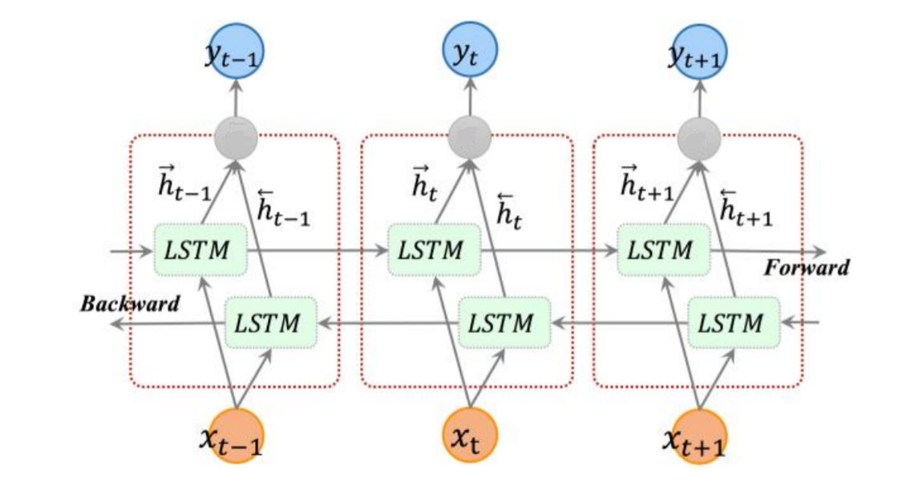
Model Architecture:
FC layer
Bi-LSTM
Bi-LSTM
w₁w₂ w_{c}
project into embedding space
Input sentence
Figure 1a. BiLSTM internal architecture (courtesy)
Figure 1b. Stacked BiLSTM

Slide 5
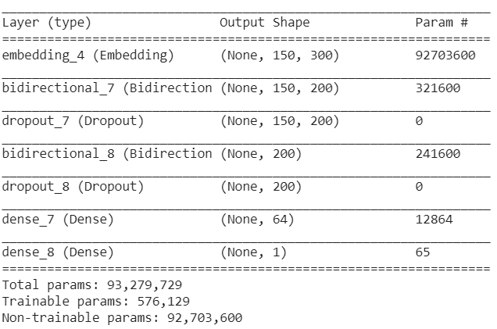
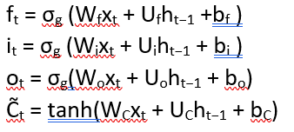


Model summary
Model:
Stacked bidirectional LSTM model, with 2 BiLSTM layers, a ReLu activated fully connected layer on top, and an sigmoidal output layer. Figure 1b. gives an overview of our model.
We used Keras CuDNNLSTM layer while constructing the model, which implements a standard LSTM layer. Fig 1a. gives an overview of the BiLSTM structure. The input gate, the forget gate, the output gate and the input cell state, which are represented in the LSTM cell in Fig. 1a, can be represented ad:
where 𝑊𝑓, 𝑊𝑖, 𝑊𝑜, and 𝑊𝐶 are the weight matrices mapping the hidden layer input to the three gates and the input cell state; while the 𝑈𝑓, 𝑈𝑖, 𝑈𝑜, and 𝑈𝐶 are the weight matrices connecting the previous cell output state to the three gates and the input cell state. The 𝑏𝑓, 𝑏𝑖, 𝑏𝑜, and 𝑏𝐶 are four bias vectors. The 𝜎𝑔 is the gate activation function, and the tanh is the hyperbolic tangent function. From these, the cell output state and layer output state can be represented as:
Finally, in the BiLSTM layer concatenates these operations are performed in both directions, forward and backward on the sequences, thus generating two sets of hidden outputs., which are concatenated to be passed as inputs to the next layer. Each hidden output can be represented as:
Minimal tuning done on the hyperparameters, and results shown are using the optimal parameters found during the process.
Training Results
Train on 1353655 samples, validate on 451219 samples
Epoch 1/4
1353655/1353655 [==============================] - 490s 362us/step - loss: 0.1480 - acc: 0.9450 - val_loss: 0.1303 - val_acc: 0.9497
Epoch 2/4
1353655/1353655 [==============================] - 494s 365us/step - loss: 0.1250 - acc: 0.9513 - val_loss: 0.1261 - val_acc: 0.9503
Epoch 3/4
1353655/1353655 [==============================] - 494s 365us/step - loss: 0.1187 - acc: 0.9532 - val_loss: 0.1229 - val_acc: 0.9517
Epoch 4/4
1353655/1353655 [==============================] - 494s 365us/step - loss: 0.1136 - acc: 0.9546 - val_loss: 0.1232 - val_acc: 0.9522

